Slide 1

Outlier Detection & Handling
Santhosh kumar bvsrk

Slide 2
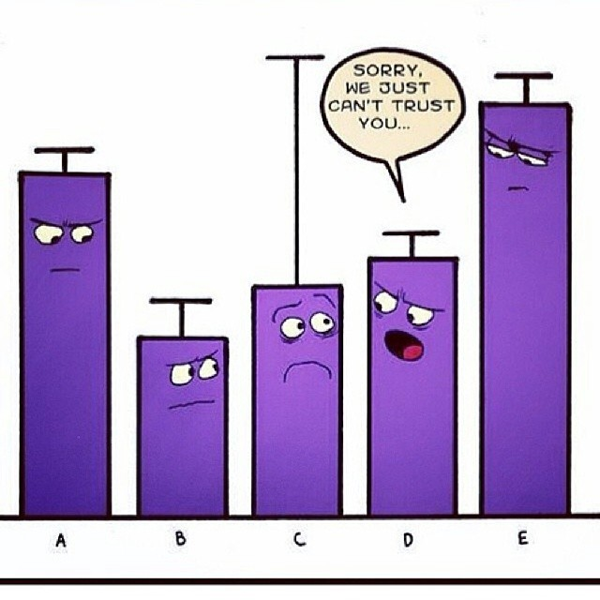

WHAT are Outliers ?
https://github.com/santhoshbvsrk/EDA-Python/blob/main/DataOutliers.ipynb
Outliers are nothing but regular data which are just a bit distant away from other observations.
Outliers can be a manual mistake in the data collected or just a variation.

Slide 3
WHY should we handle Outliers ?
Outliers handling will be done as part of Data Analysis & Data Cleaning, as without cleaning which the prediction can get biased based on the % of outlier present in data.
For example, let us say we are working on an ML algorithm to predict average salary of a Data Scientist based on their experience. If there is a discrepancy in the data shared by the client like age of employees had a typo for 52 instead of 25 and most of the employees are in the age group of 25-35.
Now, when you try predicting salary for an employee it’ll not give a prompt output.
https://github.com/santhoshbvsrk/EDA-Python/blob/main/DataOutliers.ipynb

Slide 4
HOW to Detect & Handle Outliers ?
There are multiple ways in which we can Detect Outliers of which we’ll be discussing a few here.
Using Statistics Method
Standard Deviation & Mean
Using Visualization Tools
Box Plot
Scatter Plot
Histogram
Using other Methods
IQR (Inter Quartile Range)
Z-Score
Using Tool
DTALE (Though this is not a method, this is a PIP to be installed for profiling which can help you find outliers other than providing you with lots of other data).
https://github.com/santhoshbvsrk/EDA-Python/blob/main/DataOutliers.ipynb

Slide 5
HOW to Detect & Handle Outliers (Using Statistics Method) ?
Standard Deviation & Mean:
In Statistics, if data is normally distributed then 68% of data lies within one standard deviation of the mean, about 95% of data lies within two standard deviations and 97% within three standard deviations. So, if you’ve any data point outside 3 standard deviations that can be considered as Outlier.
For finding outliers using Statistics method, we have to find out Mean, Standard Deviation, multiply Standard Deviation with 3 to get value for 3 Standard Deviations from Mean and then to find out High Range & Low Range for Outliers, it’ll be Mean + 3*Standard Deviation & Mean – 3*Standard Deviation respectively.
https://github.com/santhoshbvsrk/EDA-Python/blob/main/DataOutliers.ipynb

Slide 6
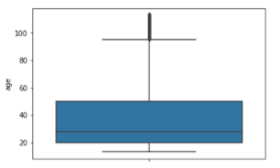
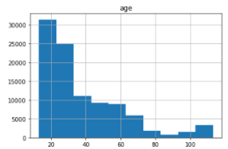
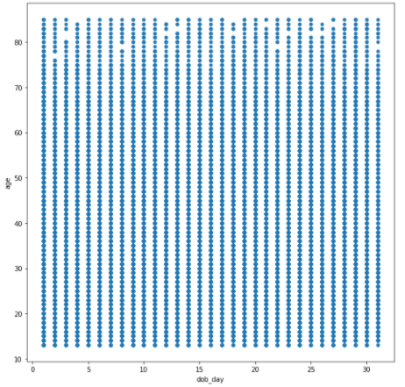
HOW to Detect & Handle Outliers (Using Visualization Tools) ?
Box Plot: The dark points in the box plot represent outliers.
Histogram: From Histogram, we can find out if it is
right skewed or left skewed, based on which we can
find outliers.
Scatter Plot: From Scatter plot we can see data points
spread over from which we can identify outlier data points
if present.
Contd…
https://github.com/santhoshbvsrk/EDA-Python/blob/main/DataOutliers.ipynb

Slide 7
HOW to Detect & Handle Outliers (Using IQR & Z-Score) ?
IQR (Inter Quartile Range): IQR is also called mid spread. In this method we’ll calculate IQR which is difference between 1st & and 3rd Quartiles i.e., Q3 – Q1.
Once, IQR is determined, we’ll calculate the upper & lower limits and any value which falls above or below these limits is an Outlier.
Upper Limit = Q1 - (1.5 * IQR) Lower Limit = Q3 + (1.5 * IQR)
Z-Score: Z-score is finding the distribution of data where mean is 0 and standard deviation is 1 i.e. normal distribution.
While calculating the Z-score we re-scale and center the data and look for data points which are too far from zero. These data points which are way too far from zero will be treated as the outliers. In most of the cases a threshold of 3 or -3 is used i.e., if the Z-score value is greater than or less than 3 or -3 respectively, that data point will be identified as outliers.
https://github.com/santhoshbvsrk/EDA-Python/blob/main/DataOutliers.ipynb

Slide 8
HOW to Detect & Handle Outliers (Using D-TALE Tool) ?
D-TALE is a Graphical Interface where we can select the data we want to analyze and how to analyze using different graphs and plots.
Using this tool, you can select a specific feature and then see outliers of that feature.
Apart from finding outliers this tool provides you lot of other features like finding Stats for each and every field.
Highlighting features which have Outliers, Missing Values, Range, Columns with same data type.
You can plot graphs between multiple features, plot a heatmap to see correlation between features.
https://github.com/santhoshbvsrk/EDA-Python/blob/main/DataOutliers.ipynb

Slide 9
THANK YOU!!!!!
Thank you for Reading.
Feel free to connect with me for any queries/corrections.
You can get code for the same from below GitHub link
https://github.com/santhoshbvsrk/EDA-Python/blob/main/DataOutliers.ipynb

